Slide 1


Leading Through Chaos & Thriving In Change
Cally Christensen, Owner & Principal Performance Consultant
Christensen & Company Consulting LLC

Slide 2

Meet Cally
Cally has over two decades in healthcare revenue cycle strategy and partnerships, she's actively volunteered with Rocky Mountain AAHAM & HFMA supporting chapters across multiple regions through committee work and education.
Currently, she serves as President for Rocky Mountain AAHAM & New Mexico HFMA. A s a national speaker and keynote, Cally's dynamic, engaging style delivers immediate results and lasting solutions.

Slide 3

Self-
actualization
Esteem
Love
Safety
Basic Needs

Slide 4

Suffering
So many things are vying for our attention, time & energy
Sandwiched
Overscheduled
FOMO
Keeping Up with the Jones
Constant Consumption & Consumerism
Insides v. Outsides/ Social Media
Guilt/ People Pleasing

Slide 5

Gender Differences in Burnout…
Women
Larger hippocampus = learning and memorization
Burnout Looks Like:
    Exhaustion…
    Compassion Fatigue…
    Give up = Isolate or Reach Out etc.
Men
  Larger amygdala = fight/ flight/ freeze/ fawn
    Burnout Looks Like:
    Compassion Fatigue…Exhaustion…
    Give up = What’s the use?
    Rarely Reach Out

Slide 6

Brain Cleaning Sleep
Amyloid Plaque = Cognitive Decline
    Brain's ability to clean its own house (no lymphatic system*)
REM
Sleep Deprivation
Constant Input Stream (Mono/ Multi- tasking)
Nun Study
#HealthHack

Slide 7

WHO IS DRIVING YOUR BUS?

Slide 8
INTERNAL LOCUS
A person who expects to succeed, is achievement-oriented, and will be more motivated & likely to learn
The “internals” said things like…
“I know it’s up to me”
“I must learn how to become more successful”
“I am responsible for what happens in my practice”
EXTERNAL LOCUS
People with an external locus of control are also more likely to experience anxiety since they believe that they are not in control of their lives
The “externals” believe that luck, fate, or circumstance determine whether they become successful, more than the strength and quality of their own efforts

Slide 9

INTERNAL LOCUS
My success is a result of my own efforts and abilities.
EXTERNAL LOCUS
My success is a result of luck, fate, or circumstance.

Slide 10

DON’T PAY VAMPIRE FOXES…
They suck you dry of time, energy, and resources.
Boundaries =
save your energy dollars!

Slide 11
#HealthHacks
Grace
People are going to make mistakes- yourself included
Be the safe space
Boundaries
Manage Expectations
Be Reliable & Consistent
Have Fun, Laugh
Approachability
Smile, Talk Last
Carnegie Tips
Yes, & Tell Me More
Nutrition
Eat the Rainbow
Fresh is Best
Plan Progressively
Sleep
8 to 10 hours
Sleep Sanctuary
Unplugged
Sleep Cool
Move Your Body
Sitting is the new Smoking
Functional
Schedule Your Steps

Slide 12
Table Top
Connection

Slide 13
Communication & Culture

Slide 14


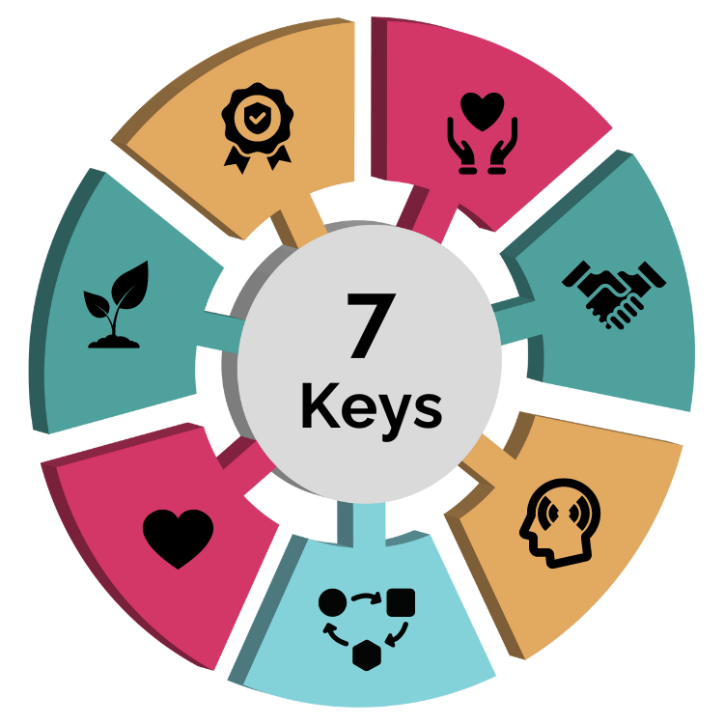






Leadership Keys
Authenticity
Living one's passions, values, and personality without compromise and empowering others to do the same.
Empathy
Putting oneself in other’s shoes. Truly listening.
Trust
Giving people the space to lead, be creative, and make decisions.
Growth Mindset
Lifelong learning and relentless curiosity.
Self Aware
Accurate self assessment, truly knowing strengths, weaknesses, and how you are perceived by others.
Love
Compassion for oneself and others. Warmth.
Adaptable
Ability to adapt to different personalities, environments, and strategy. Open to change.

Slide 15

SYNERGY & CIVILITY WITHIN OUR TEAMS
Rapport = Trust
Mistake v. Defects
Managing Real Issues in Real Time
Remote/ Hybrid/ On-Site

Slide 16
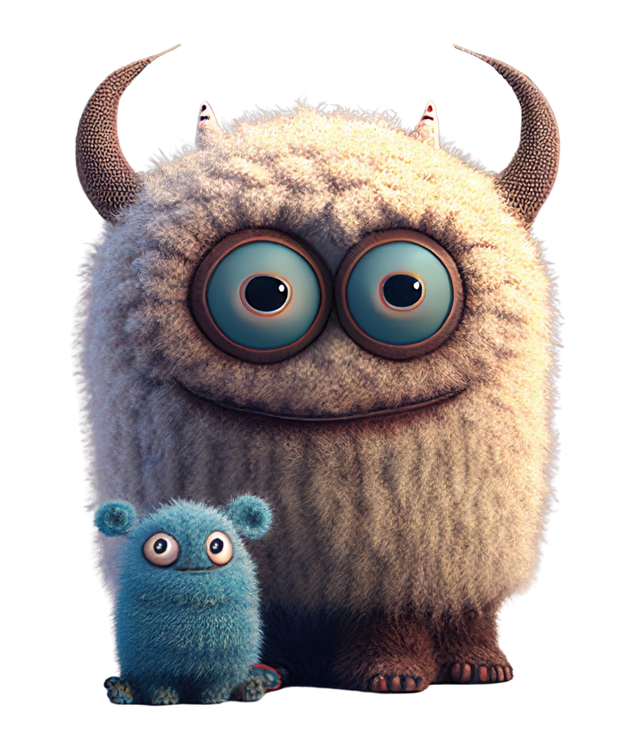
Manage the MONSTERS
    Fear (Powerlessness)/ Anger/ Resentment/ Rage
    Self Hate/ Rejection/ Judgement (Social Media)
    Triggers …Anticipate-Be Strategic
    Be Curious…Seek to Understand
    I wonder why I feel this way?
    H.A.L.T

Slide 17
CULTURE
#GoldenRule
    Do you have an open-door policy
    Do you gossip
    Are the rules the same and transparent
    Personality v. Behavior
    Subjective v. Objective
    GEMBA Walk

Slide 18

Rapport &
Smiles…
Create Safe Space
Safe To: Be Themselves,
To Take Risks (and Fail)
Safe to Innovate & Improve
“10/5 Rule”

Slide 19

Pets, Kids, Hobbies,
Vacations, Net Flix

Slide 20
DEALING WITH DYNAMIC & FEEDBACK
De-escalation Strategy
Get Present, Take Notes
Allow to Vent, Once- Use Their Name
Repeat Back, Use Their Words (NOT THEIR TONE)
Acknowledge “the inconvenience”,
“the frustration” or “the concern”
Apologize - Allow Me to Consider

Slide 21

“We are the music makers, we are the dreamers of dreams…”

Slide 22

“I trust your judgement.”
“I believe in you.”
“What do you think we should do?”
“What do you need to be successful?”
“How can I support your growth?”
“How are you really doing?”
“Tell me more about your ideas.”
“Thank you.”
“You’ve got this.”
“Let’s celebrate!”

Slide 23

Responding NOT Reacting…
Intention
Am I saying this to hurt the other person?
Will this embarrass the other person???
First thing that comes to mind
Is there a better time, place, or way to say this?
I use my judgement to decide if my words need filtering.
Choice
Is this something that needs to be said?
Did I listen properly… give them a chance to explain or apologize?
Empathy
Can I try to see the other’s point of view?
Are my words respectful? How would I feel if this was said to me?

Slide 24
You have choices each and everyday…
- choose to feel blessed
- choose to feel grateful
-choose to be excited
-choose to be happy

Slide 25




Let’s Connect.
1CallyChristensen@gmail.com
303.909.0181
in/callychristensen/

