Slide 1
Navigating a Challenging Political Landscape
Lance Kovacs, Senior Director, Health Policy & Regulation
November 14, 2025

Slide 2
Learning Objectives
Discuss the current political landscape
Appraise the shifting federal regulatory space and its impact on healthcare finances and operations
Describe State and Federal advocacy priorities for Illinois hospitals, including results of Veto Session

Slide 3
Current Political Landscape

Slide 4
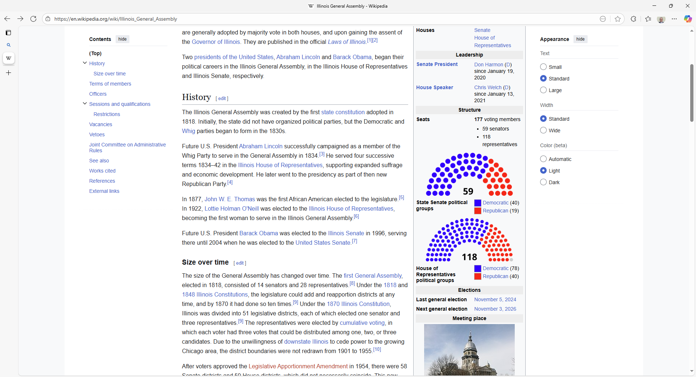
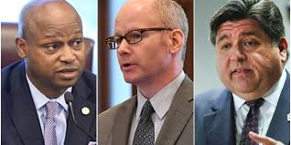
2026 Legislative Session will challenge Democratic Leaders
          Democrats’ Trifecta
          Restless progressives
          Local, regional and state pressures
          Election 2026 is underway
          Presidential ambitions

Slide 5
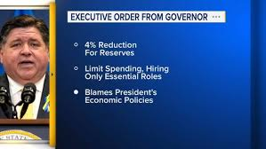
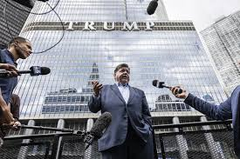
Key Issues shaping the State’s political environment in 2026
Spending constraints vs. new programs
Credit rating, education, pensions, social services, healthcare,
transportation, energy, and Chicago budget deficit
Intergovernmental tensions and federal relations
Immigration enforcement, federal funding and public safety
Electoral Dynamics
  Pritzker reelection platform, diverse and unwieldy democratic caucuses
  with regional and ideological differences, and the volatility
  from national politics providing GOP opportunities on issues of crime,
  taxes, energy and excessive spending

Slide 6
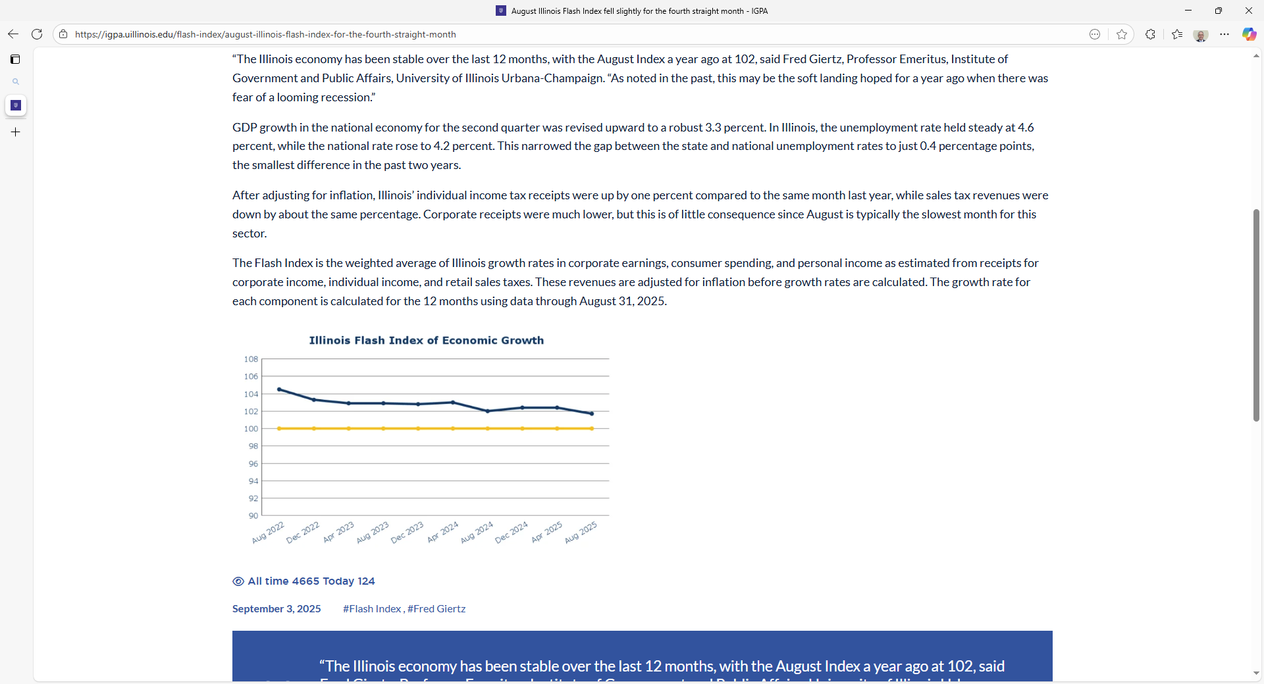
State’s fiscal and economic pressures are concerning
Current State Operating Budget Top Lines
GOMB original projection was $3.2B deficit
$55.080B Spending
$55.273B Revenues, including $4.7B in federal revenues
4% spending growth - 2% natural revenue growth
Balanced through new taxes and one-time revenues: “fund sweeps,” delaying funds,
and tax amnesty
Economic and fiscal conditions are fragile
Employment and population growth lagging; reliance on immigration
High tax burden
Public pension obligations consume 20% of the State’s operating budget, and structural fixes unlikely
U of I Flash Index of Economic Growth points to slowing economy <100 = recession
State’s fundamental strengths exist: healthcare, transportation, and skilled workforce

Slide 7
Federal Regulatory Space

Slide 8
Legislation through Regulation
Fiscal year rules were relatively routine
    Policy changes were expected:
      Rollback of SDOH quality initiatives and COVID-19 HCW vaccination measures
      Modifications to TEAM
Calendar year rules are a different story
    Legislation through regulation
    Site-neutral payments for drug administration services
    340B clawback changes and drug cost survey
    Revised hospital price transparency requirements
    Collection of market rates to set IPPS relative weights
    Elimination of IPO list
We expect to see more of this moving forward

Slide 9
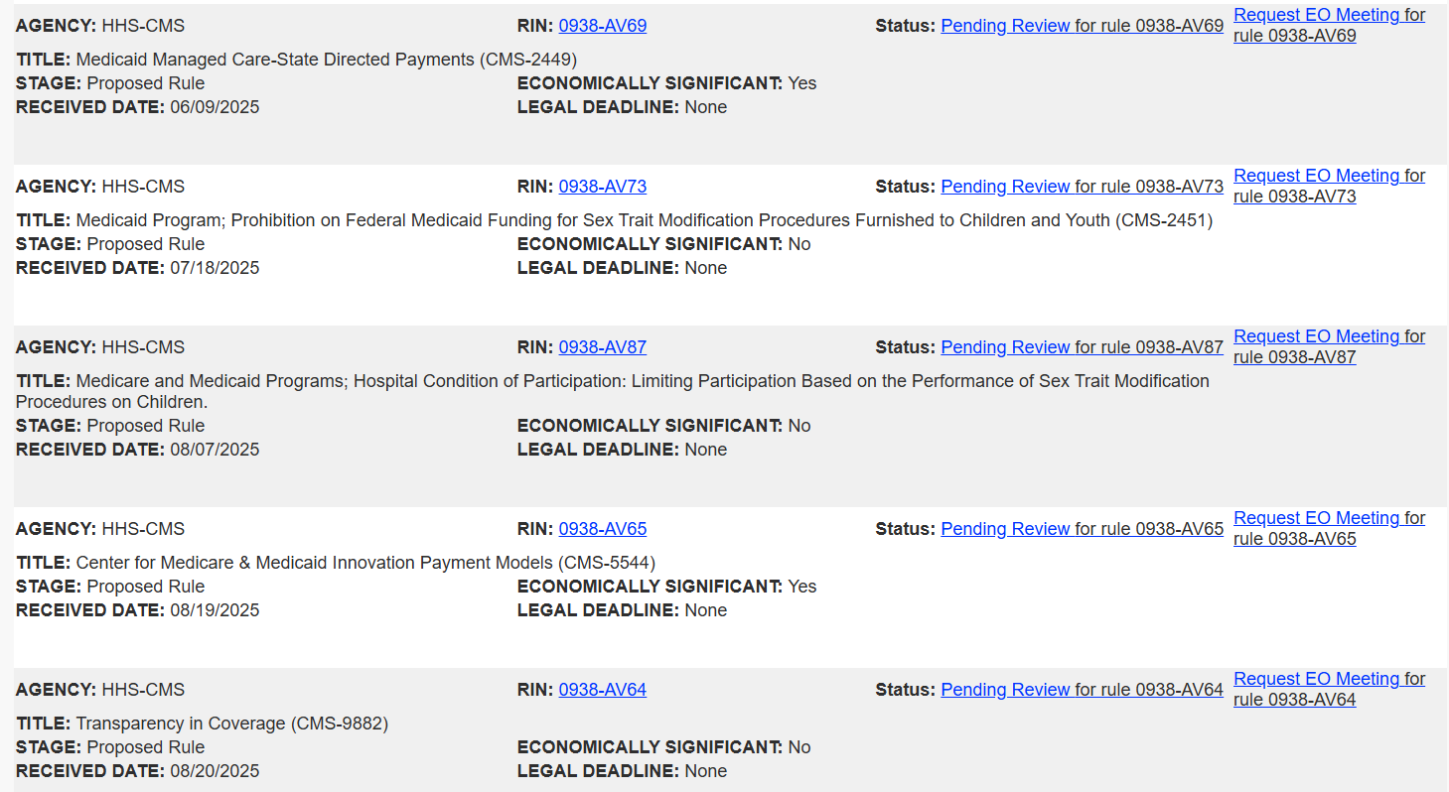
Additional Regulations at OMB

Slide 10
State and Federal Advocacy Priorities

Slide 11
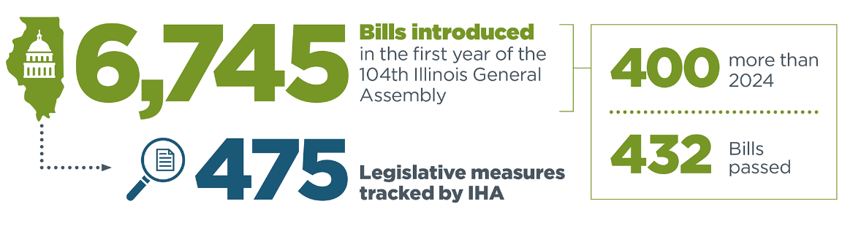
2025 Spring Legislative Session Overview

Slide 12
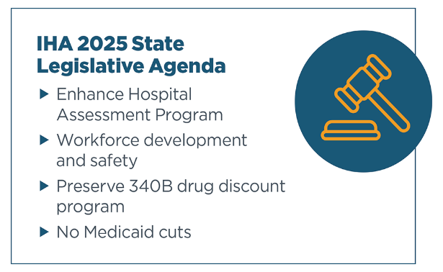
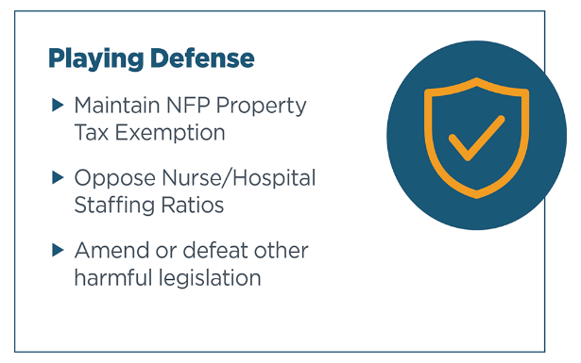
Critical Legislation: Advancing and Blocking
Advancing critical legislation and blocking harmful proposals

Slide 13

Harmful Legislation We Defeated in 2025
SB 21 Hospital Staffing Levels
HB 3512 Hospital Worker Staff & Safety
SB 259 Hospital Staffing Plans Act -
SB 2022 Safe Patient Limits – Standard Nurse Staffing Ratios
SB 251 Surgical Techs
HB 1598 Surgical Techs
SB 1435 Hospital Panic Buttons
SB 1579 Patient Rights
SB 1679 Health Care Transparency
HB 2904 Health Care Transparency
SB 2437 Medicaid Doulas
HB 2423 Medicaid Doulas
SB 21 Hospital Staffing Levels
HB 3512 Hospital Worker Staff & Safety
SB 259 Hospital Staffing Plans Act -
SB 2022 Safe Patient Limits – Standard Nurse Staffing Ratios
SB 251 Surgical Techs
HB 1598 Surgical Techs
SB 1435 Hospital Panic Buttons
SB 1579 Patient Rights
SB 1679 Health Care Transparency
HB 2904 Health Care Transparency
SB 2437 Medicaid Doulas
HB 2423 Medicaid Doulas
SB 1808 Annual Hospital Report
HB 3674 Annual Hospital Report
HB 3856 Fair Patient Billing
HB 3593 Fair Patient Billing
SB 1223 Fair Patient Billing
SB 2107 Hospital Billing Disclosures
SB 232 Hospital Price Transparency
HB 1431 Fee Transparency
HB 1434 Health Care Facility Fees
SB 1974 Telehealth Facility Fees
SB 2182 Facility Fees
SB 1808 Annual Hospital Report
HB 3674 Annual Hospital Report
HB 3856 Fair Patient Billing
HB 3593 Fair Patient Billing
SB 1223 Fair Patient Billing
SB 2107 Hospital Billing Disclosures
SB 232 Hospital Price Transparency
HB 1431 Fee Transparency
HB 1434 Health Care Facility Fees
SB 1974 Telehealth Facility Fees
SB 2182 Facility Fees

Slide 14
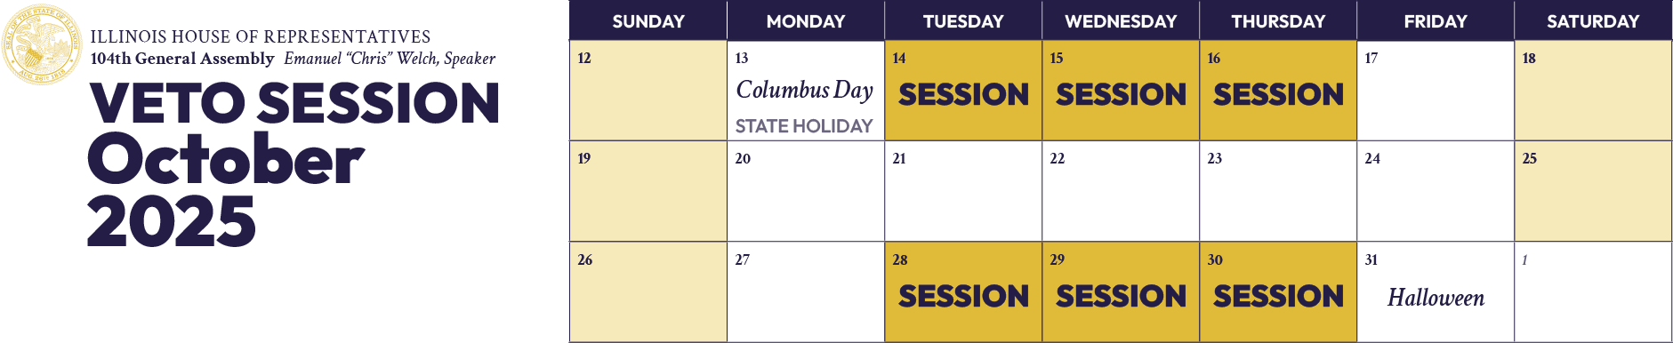
Unfinished Business: 340B
HB 2371 | SA 2

Slide 15
Busy Veto Session
Immigration Enforcement (HB 1312)
    Hospitals are to develop or revisit policies on how they interact with law enforcement
      Protocols for verifying law enforcement identity and authority, protecting patient privacy, and providing immigration rights information
Aid in Dying (SB 1950)
    Allows a patient with less than 6 months to live to request life-ending medication
    Physicians and hospitals are not required to offer this type of service
Commercial Behavioral Health Reform (HB 1085)
    Creates rate floor for services, expands coverage requirements, and provider reimbursement protections
  Immunization and Safety (HB 767)
    Establishes authority for IDPH to establish immunization guidelines for Illinois
    Requires insurance coverage to align with those guidelines

Slide 16

Looking Ahead to 2026

Slide 17

Given Current Environment, D- is Paramount
No!
  Additional Medicaid cuts or cuts impacting hospitals
  Changes to non-profit property tax exemption
  PILOTs
  Staffing ratios
  Threats to hospital finances (facility fees)
  New hospital regulations or requirements
  Changes to charity care or financial assistance requirements

Slide 18

Implement Health Care Workforce Task Force Act
Healthcare Workforce Task Force
    2025 IHA Advocacy Priority
    Signed by Governor in August
    Effective January 1, 2026
Key Issues Task Force Will Consider
    Strengthening healthcare worker recruitment and retention
    Improving the state licensure process
    Expanding workforce pipeline and training programs
    Reducing workplace violence and enhancing safety
    Promoting access to healthcare careers across Illinois
    Assessing the impact of medical liability environment on workforce
Task Force Will Make Recommendations to General Assembly for 2027

Slide 19

Implement Medicaid MCO Prior Auth Reforms
Medicaid MCO Reform
    2024 IHA Advocacy Priority
    Legislation had three buckets: standardization and transparency; 72-hour rule; and Gold Card program
Standardization and Transparency Rules
    Emergency rules effective July 1; permanent rules pending
    IHA coordinating implementation with members and MCOs
72-Hour Rule and Gold Card
    Effective July 1, 2026
    MCOs indicate significant price tag

Slide 20

Other Key State Advocacy Issues
    Illinois State-Based Exchange
    Commercial Payer Practices
    Behavioral Health
    Medical Debt
    Small Format Hospitals

Slide 21
Shifting to Federal

Slide 22
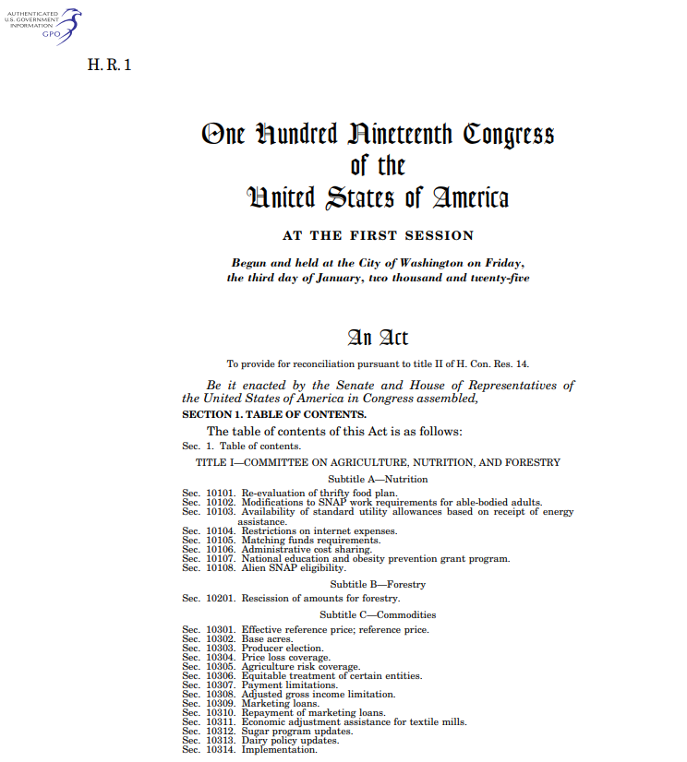
Medicaid Cuts Under H.R.1 – 3 Primary Categories
Community Engagement Requirements: $325B
80 hours per month targeting ACA expansion population
Combination of work, job training, community service or enrollment in educational program
Enrollment / Eligibility Changes: $145B
Bars HHS from implementing Biden-era rule streamlining enrollment process
Requires states to redetermine eligibility of ACA expansion population every six months
Limiting Use of Provider Taxes and State Directed Payments (SDPs): $340B
Reduces provider tax safe harbor from 6% to 3.5%
Reduces SDPs from commercial rates to Medicare rates

Slide 23
IHA Advocacy Going Forward
Educate members of Congress about implications of H.R.1
Continue to take every opportunity to explain reimbursement cuts to hospitals and resulting service and job reductions
Engage with the media to tell our story
Share serious challenges going forward in maintaining access to care
Work with the state on $50B Rural Health Transformation Program
Illinois will receive $100M per year for 5 years – at a minimum
Collaborate with AHA
Work with AHA to delay implementation and pursue changes

Slide 24

Additional End of Year Advocacy Priorities
Extend Pandemic Flexibilities and Supports
Extend telehealth and hospital at home (H@H) programs.
Extend marketplace enhanced premium tax credits
Protect Rural Hospital Programs
Extend the Medicare-dependent hospital (MDH) program
Extend the enhanced low-volume adjustment (LVA) policy
Prevent Cuts to Hospitals
Oppose site-neutral payment policies
Delay Medicaid Disproportionate Share Hospital (DSH) cuts
Oppose 340B Rebate Pilot Program
Support Hospital Workforce
Pursue healthcare exemption from new H-1B Visa fee
Support the Save Healthcare Workers Act (S. 1600/H.R. 3718)
Notes:
which supports rural hospitals that are more dependent on Medicare revenue.
, which supports hospitals with fewer than 3,800 Medicare discharges.

Slide 25

Questions? Comments?

